Slide 1


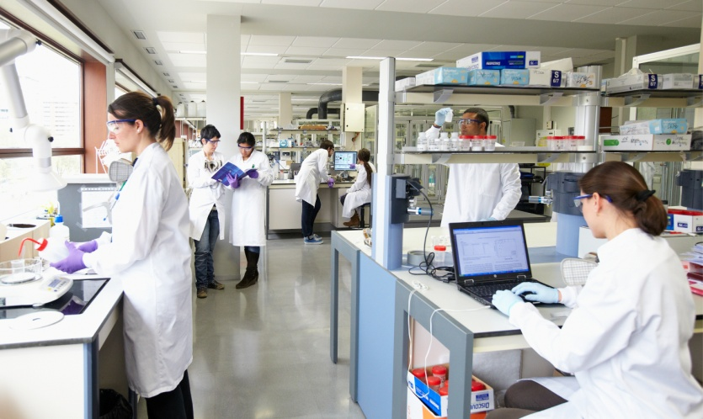
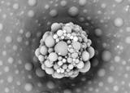
MASTER GRANTS
&
PRAKTIGES SUMMER INTERNSHIPS
3rd and 4th year students
Chemistry, Chemical Engineering and Materials Science
Research areas:
Advanced Polymer Synthesis
Waterborne Dispersed Polymers
Polymer Blends and Nanocomposites
Advanced Multiphase Polymers
Tuneable and Stimuli Response Membranes
Polymers for Biomedical Applications
Organic Electronics
Hybrid Materials for Photovoltaics
Energy Storage
Theory and Simulations
Applicants must send their academic record and CV to idoia.azaldegui@polymat.eus
www.polymat.eu
Centro Joxe Mari Korta
Avda. Tolosa, 72
20018, Donostia-San Sebastian

Slide 2
Research Topics
Praktiges
Charge transport in synthetic semiconductors (Prof. Aurelio Mateo-Alonso amateo@polymat.eu )
Improving the stability of Perovskite solar cells through the use of bulky organic substituents (Dr. Juan L. Delgado juanluis.delgado@polymat.eu )
Bio-based polymer latexes for coating and adhesive applications (Prof. María J. Barandiaran mariaje.barandiaran@ehu.es )
Determination of flame retardancy properties of on nanocomposite polymer blends by cone calorimetry (Prof. Alejandro J. Muller alejandrojesus.muller@ehu.es )
Theoretical design of nitroxide agents in controlled radical polymerization (Dr. Fernando Ruipérez fernando.ruiperez@polymat.eu )
Elucidating membrane fouling phenomena (Prof. Thomas Schäfer thomas.schafer@ehu.es)
Temperature responsive adhesives (Prof. José M. Asua jm.asua@ehu.es )
Master Thesis
DNA in ionic liquids: computer-aided design of biosensors (Prof. Ronen Zangi r.zangi@ikerbasque.org and Prof. Thomas Schäfer thomas.schafer@ehu.es )
Structure, morphology and crystallization of copolymers and terpolymers with more than one crystalline phase ( Prof. Alejandro J. Muller alejandrojesus.muller@ehu.es )
Synthesis of polymer electrolytes for batteries based in polycarbonates using organocatalysis (Prof. David Mecerreyes david.mecerreyes@ehu.es )
Synthesis of conjugated bidimensional polymers (Prof. Aurelio Mateo-Alonso amateo@polymat.eu )
Perovskite solar cells: novel polymeric hole carriers for a better solar to electricity conversion eficiency (Dr. Juan L. Delgado juanluis.delgado@polymat.eu )
Reactive processing of polylactic acid based polymer blends (Prof. José I. Eguiazabal josei.eguiazabal@ehu.es )
Applicants must send their academic record and CV to idoia.azaldegui@polymat.eus
www.polymat.eu
Centro Joxe Mari Korta
Avda. Tolosa, 72
20018, Donostia-San Sebastian

